Slide 1

Motorcycle Breakdown Assistance Application
Muhamad Ekhmal Syafiq bin Zamri (SW01080790)
Mohd Hazli Bin Mohamed Zabil, Ts. Dr.
Supervisor

Slide 2
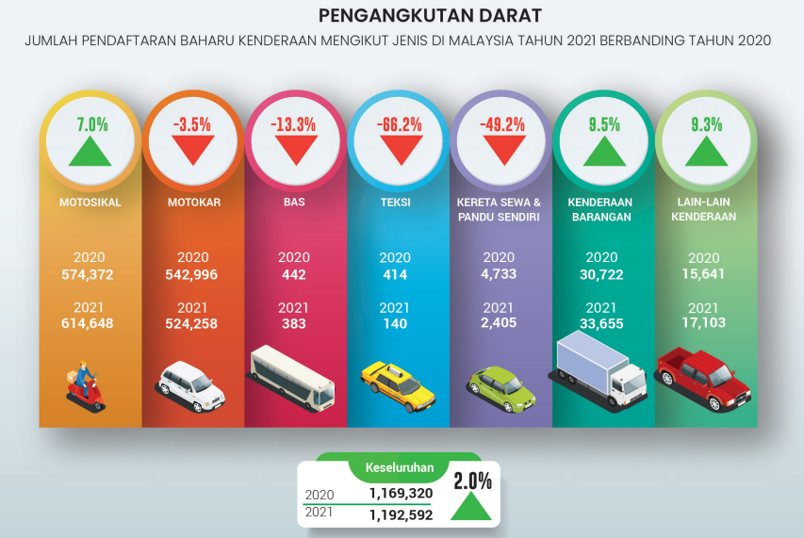
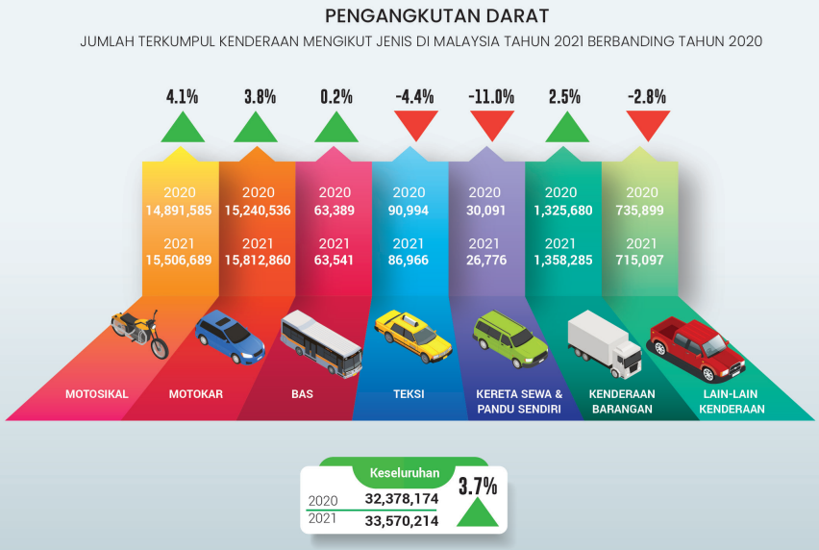
INTRODUCTION
Figure 1
Figure 2
Source: Ministry of Transport Malaysia, Official Portal

Slide 3



PROBLEM STATEMENTS
Time consuming and inefficient to request for assistance manually
High risk of scams or fraud

Slide 4
OBJECTIVES
To reduce by at least 90% on the risk of towing scams and fraudulent for riders.
To reduce time consumption to 5 seconds for riders to search and request for an assistance.
To increase the efficiency for riders to request for assistance by 60%.

Slide 5

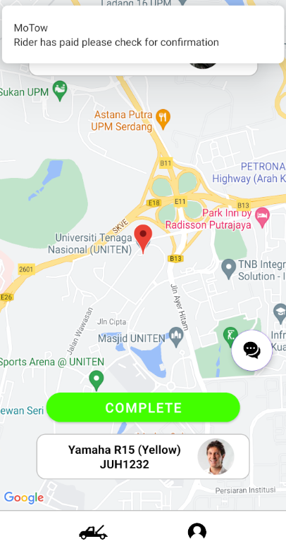
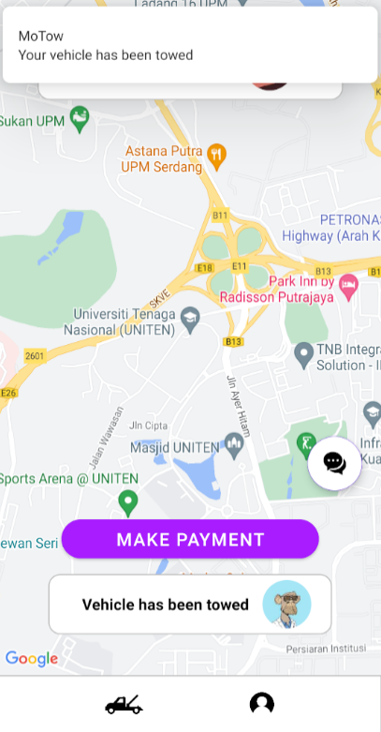
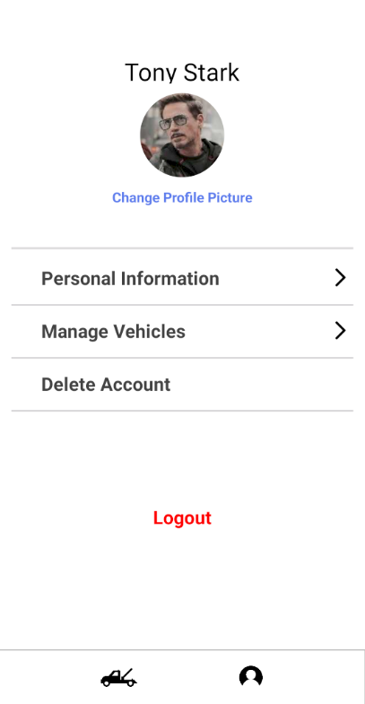
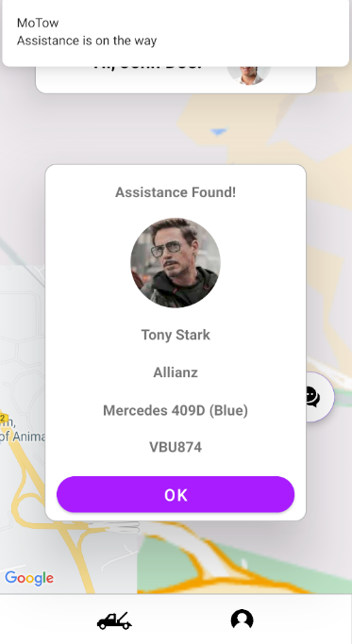
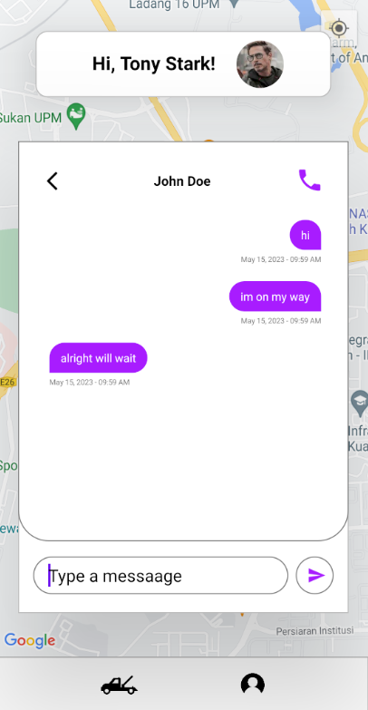
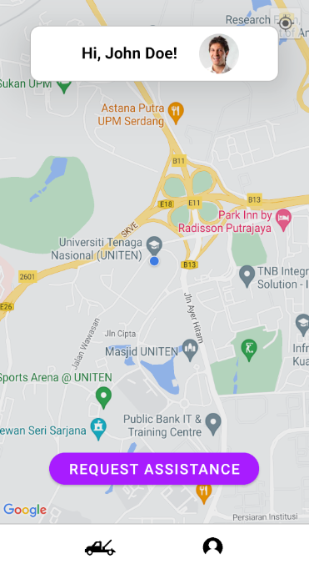
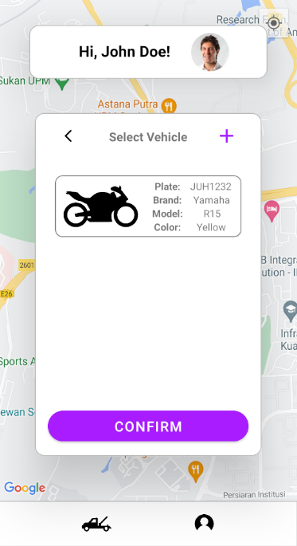
DEMO
APK: Release v0.0.0-alpha · Malsyaf/MoTow (github.com)

Slide 6
REFERENCES
Ministry of Transport Malaysia. (2022). Ministry of Transport Malaysia Official Portal Home. Ministry of Transport Malaysia. https://www.mot.gov.my/en/Statistik%20Tahunan%20Pengangkutan/Transport%20Statistics%20Malaysia%202020.pdf
Objectives and goals: Writing meaningful goals and smart objectives. Objectives and goals: Writing meaningful goals and SMART objectives - MN Dept. of Health. (2023, March 3). https://www.health.state.mn.us/communities/practice/resources/phqitoolbox/objectives.html#:~:text=A%20SMART%20objective%20is%20one,organization%20will%20achieve%20a%20goal.

Slide 7
THANK YOU

